Slide 1
Business Analysis
Planning in creating a requirement document

Slide 2
Topics
Business Analysis
Business Analyst
Business Requirement Document
Requirements Gathering Techniques

Slide 3

Business Analysis
A process of identifying business needs, analyzing problems, and recommending solutions that help organizations achieve their objectives. It involves gathering and interpreting data, modeling and documenting processes, and facilitating communication between stakeholders.

Slide 4
Business Analyst
Bridges the gap between stakeholders and the development team, interpreting business requirements into understandable development tasks to match a final software product with the expected business value.

Slide 5
Business Analyst Role
Requirements Gathering | System Design | Development | UAT | Maintenance
Works with business stakeholders to identify, document, and analyze business requirements. Ensures that the requirements are clear, concise, and align with the business goals. | Creates detailed specifications for the development team to follow. Works with the development team to ensure that the solution meets the requirements and is feasible to develop. | Liaise between the development team and the business stakeholders, ensuring that the solution meets the requirements and is aligned with the business goals. | Ensures that the testing is comprehensive and that all requirements are tested, and issues are identified and resolved. | identify issues and enhancements to the solution to ensure that it continues to meet business needs. Works closely with business to identify opportunities for continuous improvement.

Slide 6
Must Have Skills for Business Analyst
Analytical thinking and problem-solving skills
Communication and interpersonal skills
Business acumen and domain knowledge
Technical skills, such as SQL, Excel, and data analysis tools
Time management and organizational skills
Attention to detail and accuracy
Leadership and teamwork skills

Slide 7
Best Practices
Research
Create Visuals
Be Clear and Concise
Validate
Get a Sign-off
Notes:
Research Refer to past projects, look for available templates or requirement document samples
Create Visuals
Research has proved that our brain processes visual data 60,000 times faster than textual data. So, instead of writing walls of text, consider mixing it up with some infographics, flowcharts, Venn diagrams, etc.
Be Clear and Concise
RD is oftentimes confusing so don’t confuse your stakeholders more. To avoid misunderstandings, short, clear sentences with a minimum of techy talk are recommended.
Validate
It's a good idea to have a group of subject matter experts and project stakeholders check the document and leave feedback. Revision reduces the chance of critical error and ensures that all necessary information is included.
Get a Sign off
Confirms what is agreed upon. Locks the scope.

Slide 8
Requirements Gathering Techniques
Interviews
Questionnaires or Surveys
User Observation
Document Analysis
Interface Analysis
Workshops
Brainstorming
Role-Play
Use Cases and Scenarios
Focus Groups
Prototyping
Notes:
Interviews
Ask open-ended questions. Open-ended questions are those that cannot be answered with a simple “yes” or “no.” They draw out specific information.
2. Questionnaires – provide probing questions to get those underlying requirements
3. User Observation - By observing end users in the real context in which they perform their tasks, you’ll gain a true understanding of what they are up against and what improvements they need so they can perform better. You’ll then be better able to specify a system that successfully reinvents users’ processes and grants them far greater productivity and usability, rather than simply providing them an incremental improvement.
4.Document Analysis – Review of system requirements, user manual and if available problem reports.
5. Interface Analysis – End user interface, system components the system interacts with, external systems the system interacts with
6. Workshops
Once you have a broad set of candidate requirements defined and organized, convene your stakeholders and hash through these candidates together. Gather additional detail. Give a fair hearing to opposing views. Grant everyone ample opportunity to provide the rationale for their positions.
Seek to resolve discrepancies and conflicts, gain consensus, and validate your requirements. These activities are vital to ensuring your system will best meet the needs of all users and stakeholders, not just the most vocal groups.
7. Brainstorming
In your brainstorming session, consider different parts of the system individually. Explore various what-if scenarios and blue-sky ideas. The general idea is to break away from existing conventions. Consider visionary ideas for pushing current boundaries.
Useful tools for brainstorming sessions include whiteboards, mind mapping software, and empathy maps (the latter for exploring user needs).
8. Role Play - In a role-play session, different people take the roles of the different user types. Having the various roles interact with one another helps examine individual system requirements from different perspectives and generates discussions and new ideas.
9. Use Cases and Scenarios
Use cases are the specific, individual business objectives the system must accomplish and the various situations in which a given feature or functionality will be used. They describe the various external entities that act on the system and the specific interactions they have with the system to accomplish the business objective. Use cases are expressed as step-by-step lists of tasks performed during a process.
Scenarios, also called user stories, are similar to use cases in that they describe how the system will carry out a process to fulfill a business objective. Their form, however, is a narrative, rather than an enumerated list.
10. Focus Groups - typically involve external stakeholders to provide feedback on the product, express their need and help guide your software development
11. Prototyping
Trial of the prototype by users
Feedback from users
Modification of the prototype

Slide 9
Types of Flow chart
Process Flowchart
most common type
illustrates the steps of plans, projects, production processes, etc.
Workflow Chart
Indicate the flow of materials and data in an organization
Good for explaining business operations
Swimlane flowchart
To clarify the interaction process between different employees, departments and processes involved in the business
Data Flowchart
Explains the input and output flows in an information system

Slide 10
Process FlowChart
Start
Enter User ID, Password
Valid User ID?
Yes
Valid Password?
Yes
Proceed to Main Page
End
Display "Invalid User ID or Password"
No
No

Slide 11
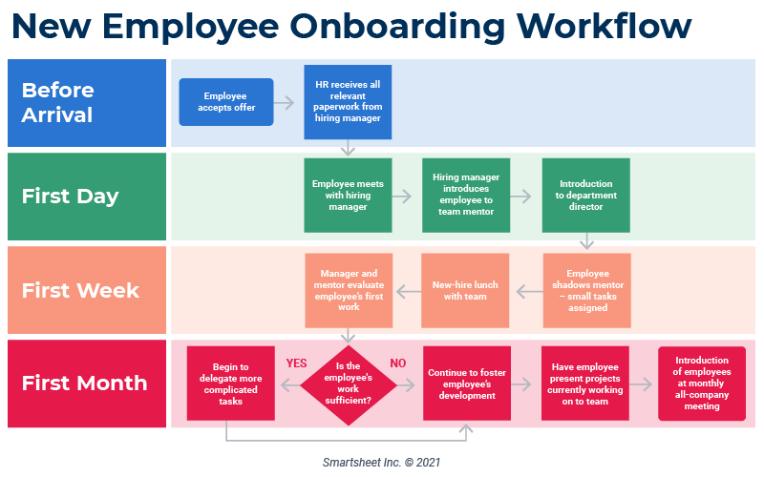
Workflow Diagram

Slide 12
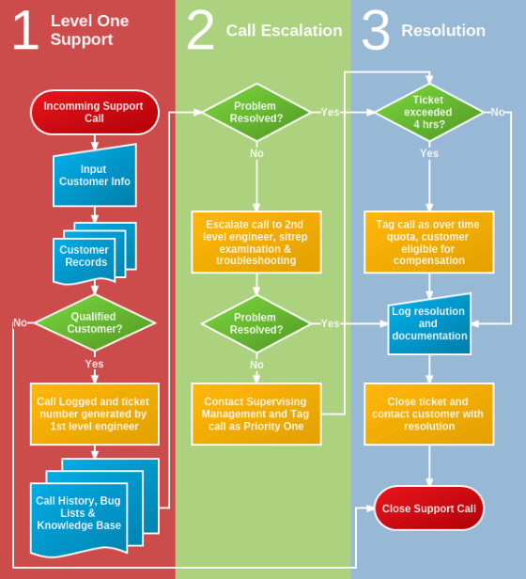
Workflow Diagram

Slide 13
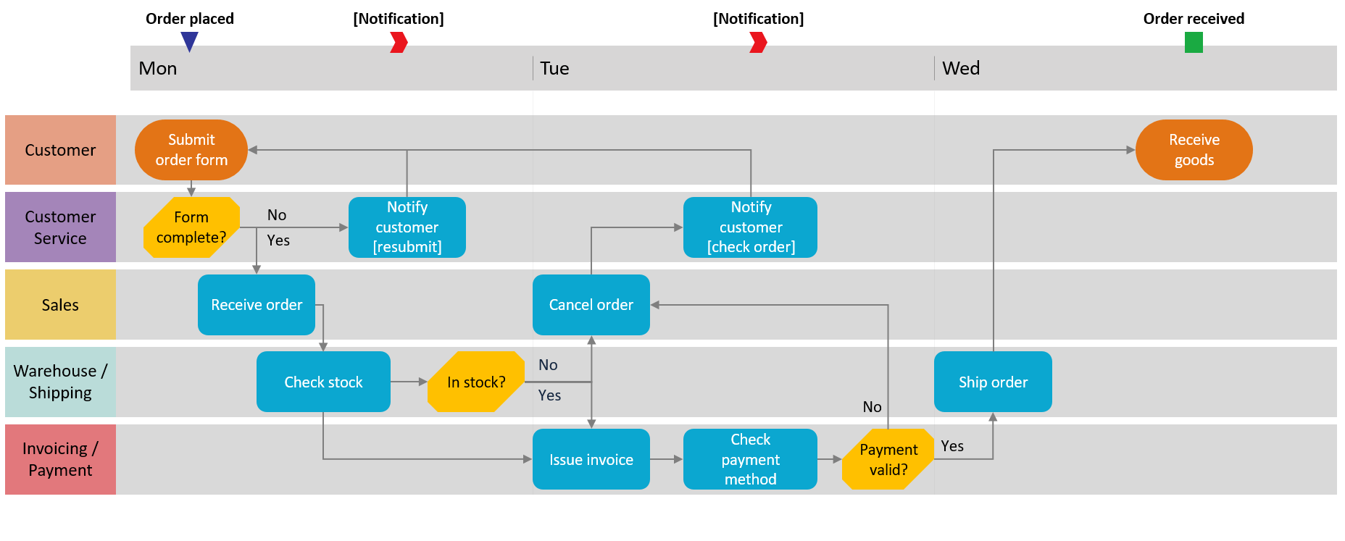
Swimlane Diagram

Slide 14
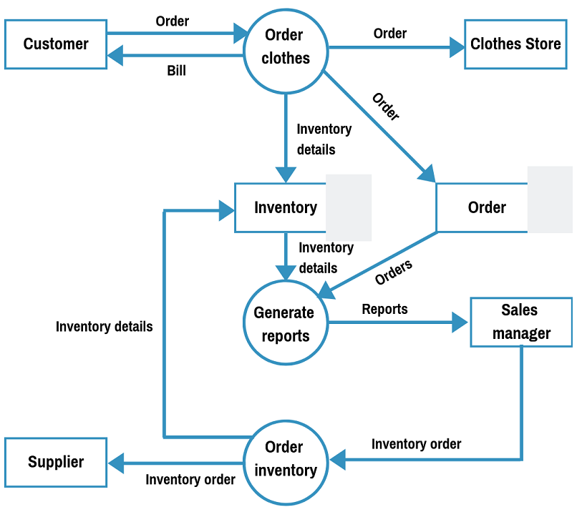
Data Flow Diagram

Slide 15

Business Requirements Document

Slide 16
What is a business requirements document (BRD)?
A report detailing everything a new project requires for success. It outlines project objectives, what's expected throughout the project lifecycle, and what's required to accomplish the project
A formal description of business-related objectives and expectations an organization has regarding a specific project or business solution. It commonly explains reasons to start a project, the set of business values it is expected to provide, and the purpose behind doing the project, etc.
Notes:
The main idea of a BRD is to clarify all the business aspects of a project.

Slide 17

Business Requirement Document vs Functional Requirement Document

Slide 18
People Involved in Creating a BRD
Business Analyst
Development Team
Project Managers
Business Partners
Top Level Managers
Subject Matter Experts
Project Sponsors

Slide 19

Components of a BRD
Executive Summary
Project Objectives
Project Scope
Business Requirements
Stakeholders
Project Constraints
Cost Benefit Analysis

Slide 20
Executive Summary
Problem Statement
Proposed Solution
Solution's Value
Conclusion and Next Steps

Slide 21
Project Objectives
S.M.A.R.T
Consider KPIs specific to the project
Leave no room for misinterpretation
Example:
Create a website that will increase organic search traffic by 25% a year after the site has been launched
Implement a new online ticketing system by a certain date to achieve ticket response times of no more than an hour
Create a mobile version of the core functionality of the current web banking application which must be user-friendly, responsive, and accessible to smartphones and tablets at all times

Slide 22
Project Scope
Timeline
Budget
Deliverables
Project Requirement
Project Team

Slide 23

Business Requirement
List the actions required to accomplish the project
Rank by priority based on criticality

Slide 24
Stakeholders
Team Members
Project Manager
Executives
Clients

Slide 25
Project Constraints
Project Risks
Team Availability
Resources
Project Dependencies
Deadlines
Budget

Slide 26
Cost Benefit Analysis
Describe all the costs associated with your project
Explain the associated benefits
Write the total expected cost of your project
Estimate the expected ROI by subtracting your estimated costs from your estimated income

Slide 27

Gap Analysis
Gap analysis is a critical tool for business analysts in identifying areas for improvement and developing effective strategies to close the gap between the current and desired state of a process, product or service. It helps organizations to identify areas of weakness, and develop plans to overcome them, as well as to capitalize on areas of strength to achieve their objectives.

Slide 28
Key Elements of Gap Analysis
Identify the current state
Define the desired state
Analyze the gap
Develop an action plan

Slide 29

Gap Analysis Document
Area
Current State
Future State
Identified Gap
Action Plan
Priority Level

Slide 30
Sources
https://www.altexsoft.com/blog/business-requirements-document/
https://www.zenflowchart.com/how-to-make-flowcharts
https://www.linkedin.com/pulse/how-conduct-gap-analysis-business-analyst-john-samwani-agileba
https://www.jamasoftware.com/requirements-management-guide/requirements-gathering-and-management-processes/11-requirements-gathering-techniques-for-agile-product-teams

Slide 31

Question & Answer

